Slide 1


Predicting Bitcoin Price by the Minute
Nader Liddawi

Slide 2
Bitcoin
Digital currency
Decentralized and Anonymous
Based on Cryptography (math discipline)
Popular in financial markets since 2017
Spot vs. Futures

Slide 3
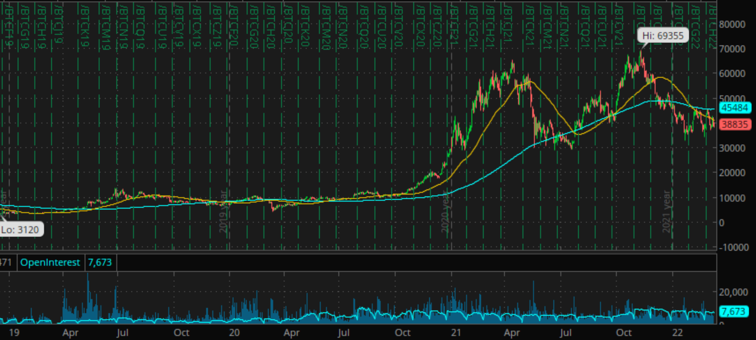
Bitcoin Futures Daily Chart

Slide 4
Motivation
Banks or Market Makers help institutional investors buy or sell bitcoin
Help is necessary so as not adversely to push the price up or down
Market Makers can buy or sell a little at a time throughout the trading day, and then sell to hedge fund at the average purchase/sale price +/- risk premium
Not only should Market Makers split their purchases or sales across the day, they should also know when to purchase so as not to push price up or down and to achieve price improvement for clients

Slide 5
Objective
We can build mathematical model to help Market Maker know when to buy
That is, we can build a classification model that predicts whether the next minute will be up or down based on past value(s)
If prediction is up, then don’t buy in hopes not to push price further up
If prediction is down, then buy since predicted down tick will more likely offset the effect of purchasing shares
If Market Maker objective is to sell, then above two points will be reversed

Slide 6
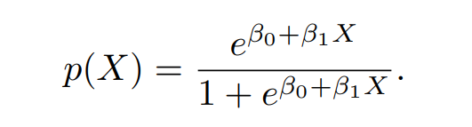
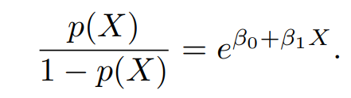
Logistic Regression
Logistic Function that gives output ranging from 0 to 1 (i.e., class #1 or class #2)
Odds of Success / Failure

Slide 7
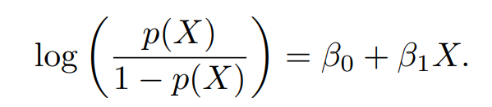
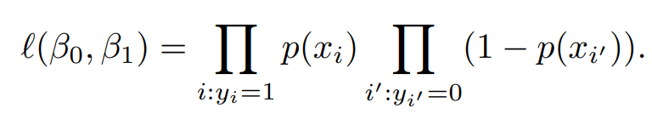
Fit the Model
Take the Log of the Odds
And then, fit the model via Maximum Likelihood Estimation (i.e., MLE)

Slide 8
MLE Steps
1. Take the Log of the Likelihood Function
2. Simplify the equation
3. Take the partial derivative with respect to the parameter B0
4. Set equation equal to 0
5. Solve for parameter B0
6. Repeat loop but now solve for B1

Slide 9
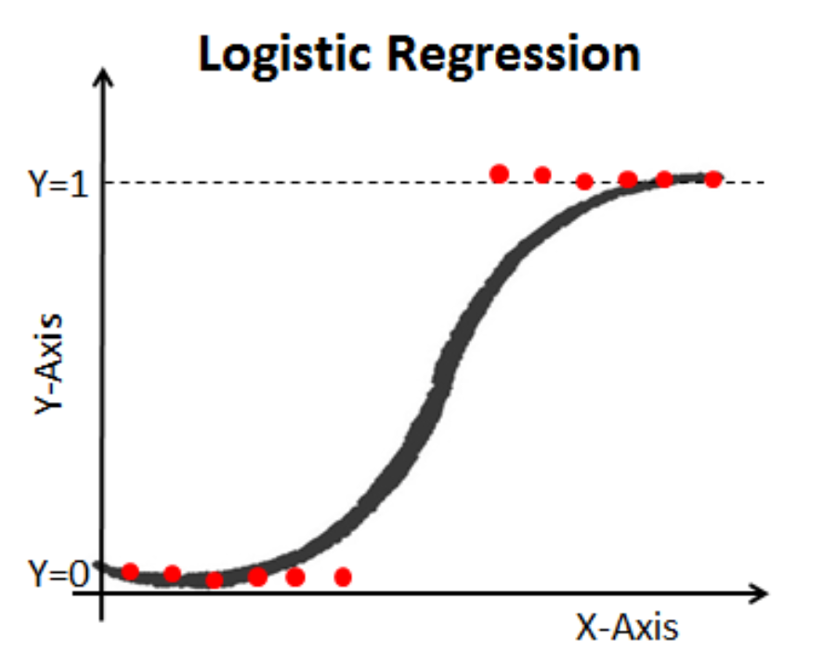
Intuition Behind MLE
Find B0 and B1 such that plugging these parameter estimates back into p(X), shown below, yields a number close to 0 for Down minutes and a number close to 1 for Up minutes (i.e., our observations in the S-curve)
X is Lag 1 return (-∞, +∞)
B0 and B1 is found via MLE

Slide 10
Bitcoin Data
We need bitcoin minute tick data on which to fit (i.e., train) the logistic regression model
Data will be of bitcoin spot closing price per minute from Jan. 2021 to March 2022
Over 600,000 data points, with active weekend trading
Data Source: https://www.cryptodatadownload.com/data/bitstamp/

Slide 11
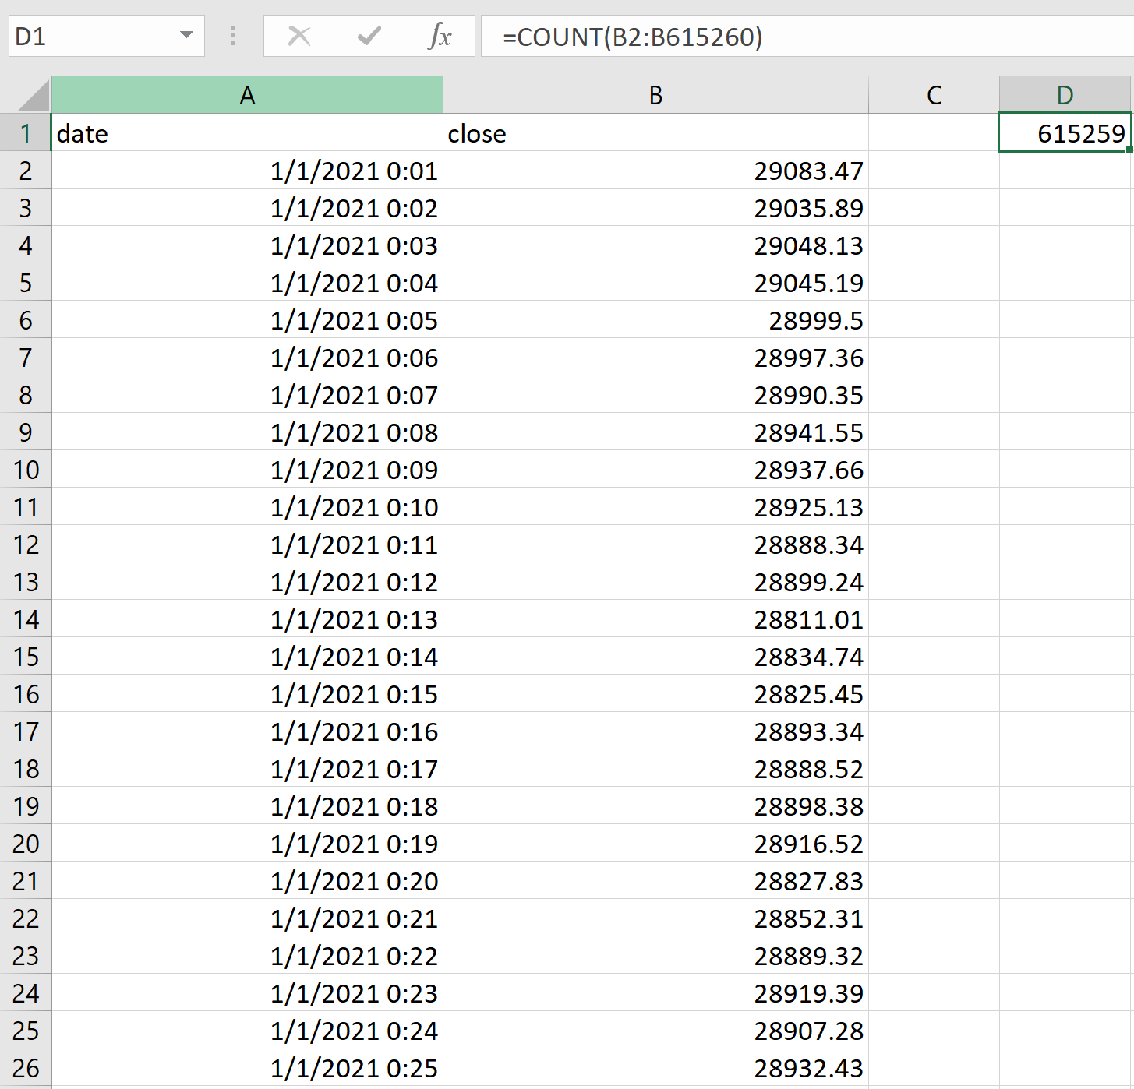
615,259 minute ticks of Bitcoin spot price

Slide 12
Splitting the Data
We will split the data into 80/20 divide to avoid over-fitting our model to the idiosyncrasies of a sample set
80% of the first part of the data from Jan. 2021 to Dec 2021 will be used to fit the model to get our B0 and B1 estimates
20% of the last part of the data will be used to test whether our fitted model predicts accurately untrained data, by taking the y-values of the test set (0 or 1) and comparing against the y prediction (0 or 1)

Slide 13
Training Data: Y-Value
Y-value of training data (on which we will fit the model) is either 0 or 1
0 represents a Down minute tick (i.e., a negative return on the minute)
1 represents a Up minute tick (i.e., a positive return on the minute)
We begin Y-values on 1/1/2021 one minute past midnight until 12/8/2021 19:25 (EST)
492,202 data points

Slide 14
Training Data: X-Value
X-value of training data is lag 1, which is the return of the last minute
That is, lag 1 is last minute’s return that will be used to predict current minute’s classification as either Up or Down (positive or negative return)
Constant, representing y-intercept, will equal arbitrarily to 1
Value of constant estimate does not matter; the constant merely adjusts the average fitted probabilities to the proportion of ones in the data

Slide 15
X-Variable Selection
We can choose any number of X variables to predict whether future value will be up or down
For example, we can choose lag 2 and lag 3 (return of two and three minutes ago) or we can choose volume at lag 7, etc.
Choose X variables that are useful information for prediction
We chose only lag 1 returns because adding other X-variables, as we will see via live demonstration, will not produce greater predictive power

Slide 16
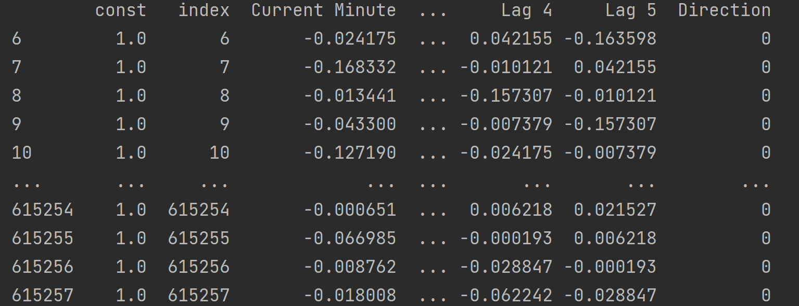
Table Representation
Y-value is the Direction column, which is either 0 if current minute has negative return or 1 if current minute has positive return
X-value is Lag 1, the return of the previous minute; more lags are shown for illustration

Slide 17
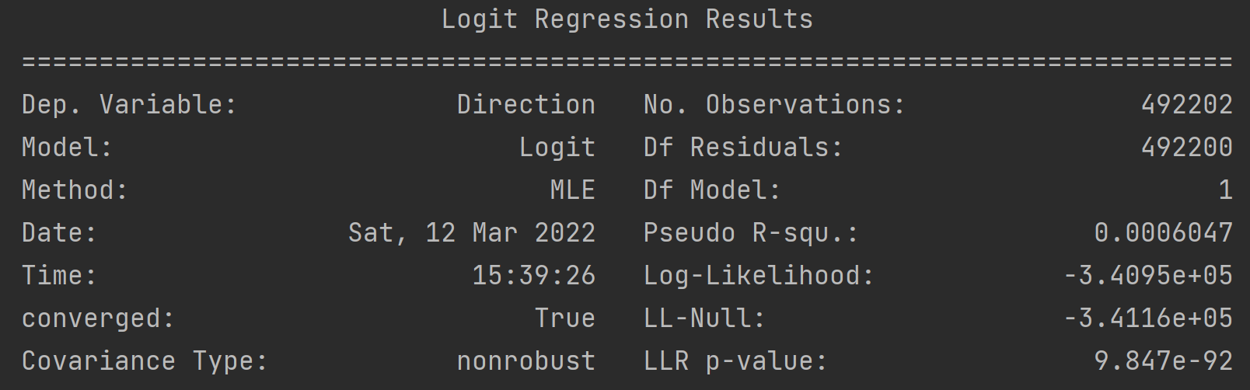
MLE Output
We can use programming language R or Python to automatically output our fitted model using Maximum Likelihood Estimation method

Slide 18
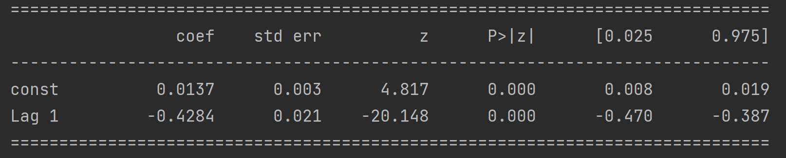
MLE Coefficients
The B0 coefficient estimate (i.e., const) that represents the intercept and the B1 coefficient estimate (i.e., Lag 1) that represents the log-odds decrease (-0.42) of Up minute for every unit increase in X are both significant to our model’s predictive power since the p-values are 0 and the z-scores are above 1.96 or below -1.96

Slide 19
Testing Data: Y-Value
The Y-value of the Testing Data is simply 0 or 1 (Down or Up minute returns) from the last 20% of our time series data
More precisely, starting 12/8/2021 19:26 until 3/4/2022 6:20 hour (EST)
123,051 data points

Slide 20
Testing Data: X-Value
X-value of the testing data will be Lag 1 return of the last 20% of the data set
Our computer program calculates the Lag 1 returns for each minute
Our program then plugs these X = Lag 1 returns into the Fitted Model and returns the predicted values p(X), ranging continuously from 0 to 1

Slide 21
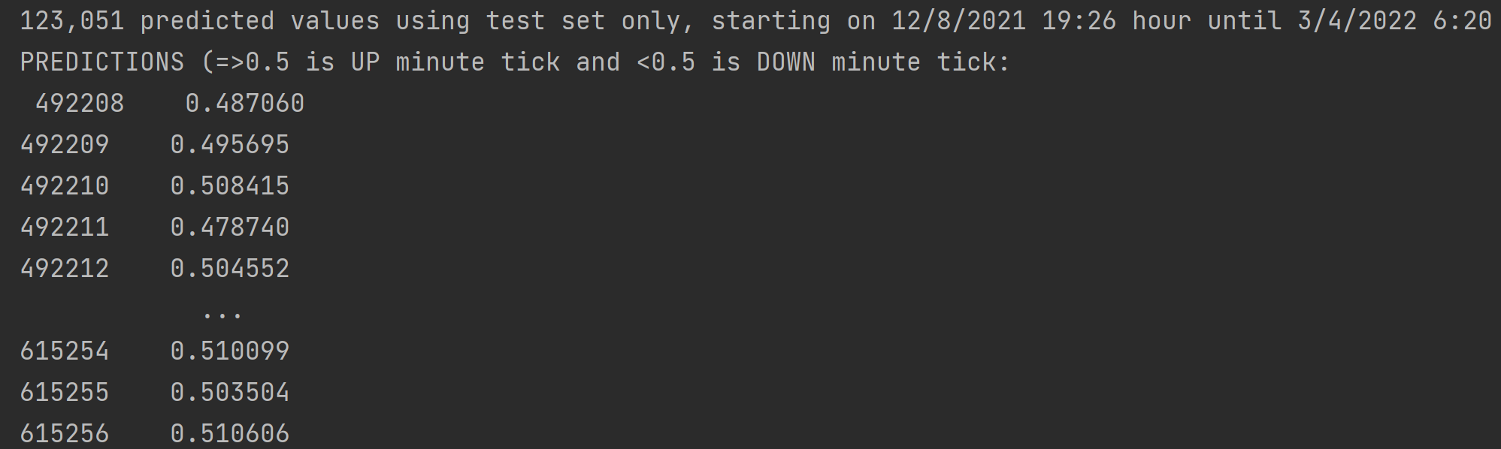
Y Predictions
If 0 <= p(X) < 0.5, then classify as 0 (i.e., Down minute)
If 0.5 <= p(X) <= 1, then classify as 1 (i.e., Up minute)
We can then compare the predicted values against the actual Y-values of the testing data set via a Confusion Matrix

Slide 22
Predictive Power: Confusion Matrix
We can use the Confusion Matrix to produce true positives and true negatives against false positives and false negatives
True Positive: We predict Up minute when Up minute is true
True Negative: We predict Down minute when Down minute is true
False Positive: We predict Up minute when Down minute is true
False Negative: We predict Down minute when Up minute is true

Slide 23
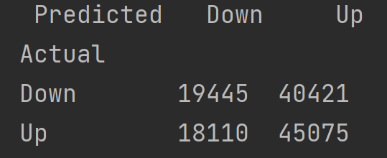
Confusion Matrix
Accurate:
True Positive: 45,075
True Negative: 19,445
Not Accurate:
False Positive: 40,421
False Negative: 18,110
Random Guessing:
50% (Frequentist Inference)
Model Accuracy:
64,520 / 123,051 = 52.43%

Slide 24
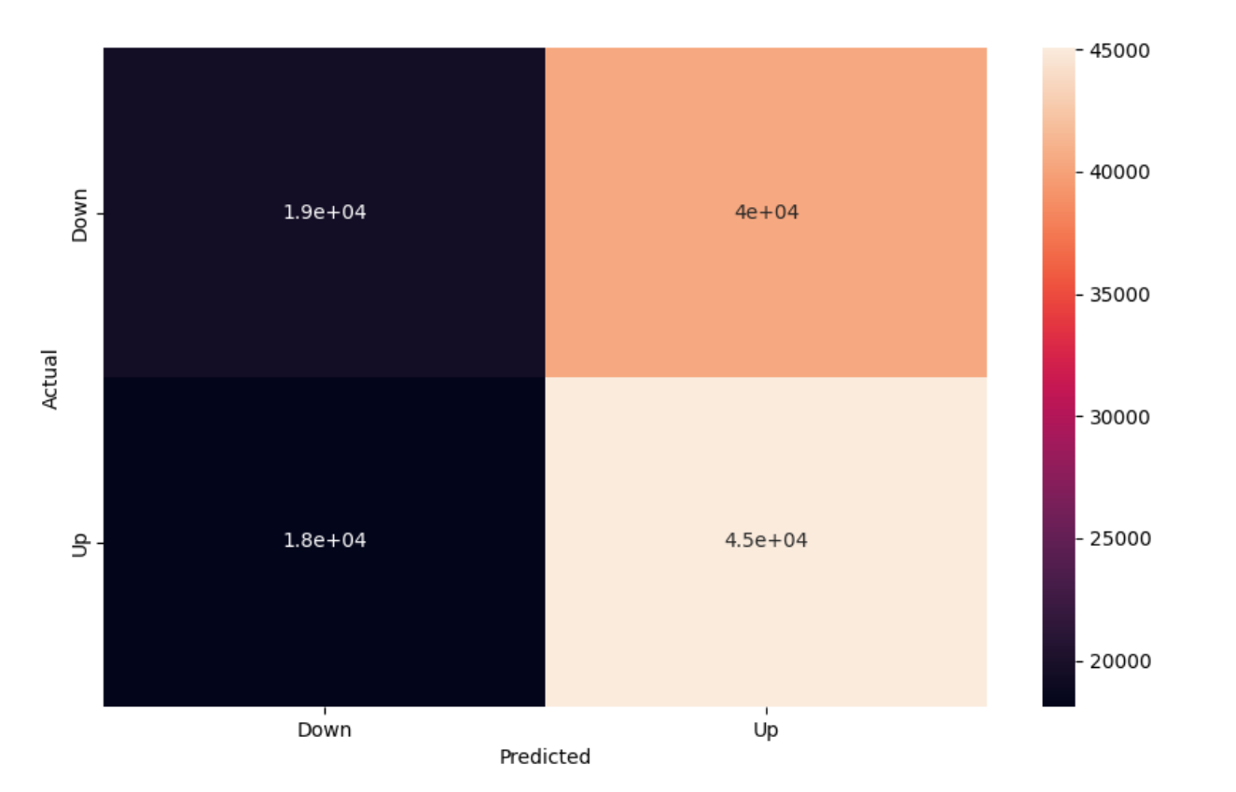
Visualizing the Matrix

Slide 25
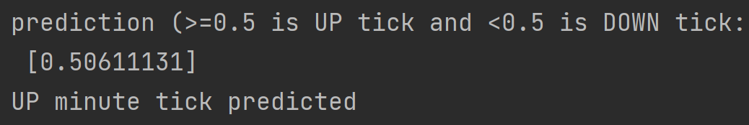
Example
Suppose we want to predict future minute tick given that we already know the last minute’s return via market observation
Let us say that last minute’s return was -0.025% (or -0.00025)
Probability p(X) equals 0.5061 via Fitted Regression Model
Since p(X) >= 0.50, we classify the future minute tick as Up and a signal not to buy or, alternatively, a signal to sell

Slide 26
Conclusion: Logistic Regression
Though the model is marginally better than guessing, it is not random and there is significant information in the past return value in predicting future classification
In other words, the model can bias the decision when to buy or sell instead of randomly choosing to buy or sell throughout the day
Of course, it is extraordinarily difficult, if not impossible, to predict future returns especially with such short time horizons because you are trying to model human decision-making which is a problem in psychology
The logistic regression is very simple and took only one X input (i.e., Lag 1)
However, this model can serve as just one signal in a more complex model Market Makers can use to automatically determine whether the bitcoin will go up or down next minute (i.e., whether to sell or buy)

Slide 27
Further Study

Slide 28
Improvement: Classification Tree
Instead of using simple logistic regression alone, we can implement in Python a tree of multiple signals at each node (with Lag 1 being just one) to determine whether to buy or not to buy at a particular minute.
Other signals can consist of RSI, z-score, etc.
RSI measures over-bought or over-sold conditions based on returns of previous 14 periods (i.e., 14 minutes)
Z-score measures the standard deviation of Lag 1’s return

Slide 29
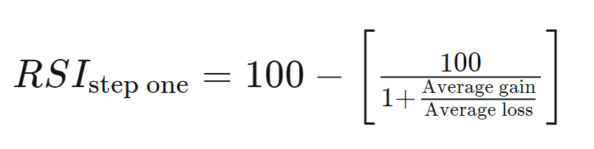
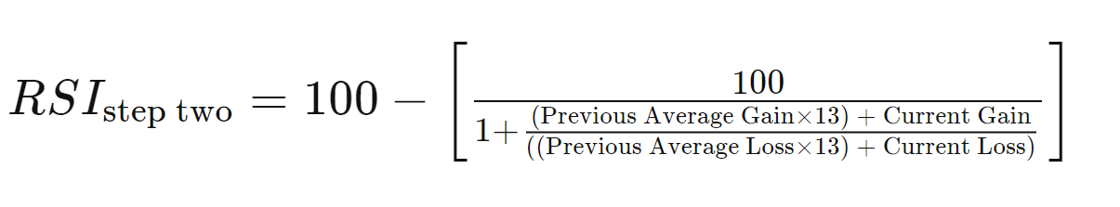
Relative Strength Index
RSI is a momentum indicator that measures whether an asset is over-bought (with RSI>70) or over-sold (with RSI<30)
Basically, RSI measures the rate of change of the current period relative to the last 14 periods
A rate of change too large in either direction can indicate a temporary reversal of trend
Constant 14, by convention, is the look-back period used to calculate the average gain or loss in Step 1
Step 2 of RSI is the smoothing function
See Investopedia for further study

Slide 30
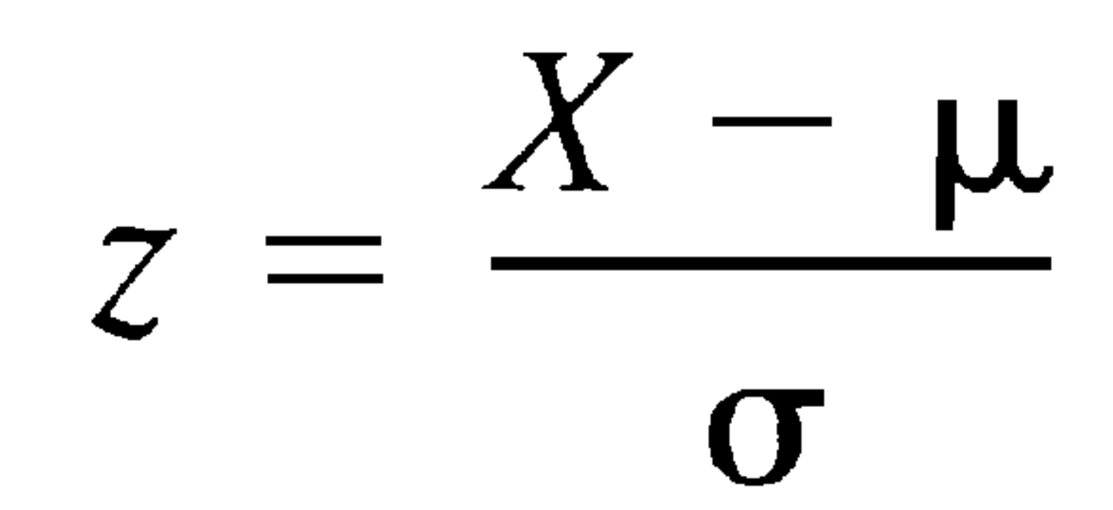
Z-Score
Z-score is the difference of a sample point (i.e., X) with the population mean (i.e., mu; approximated via sample mean in large samples) and normalized by the standard deviation of the population (i.e., sigma)
The z-score basically compares the data point with its sample mean and computes how many standard deviations from the mean the data point is
For example, if the data point is at the sample mean then we have z-score of 0 and if it is very far away from the mean (i.e., an outlier in normal distributions) then it may have a z-score at or above 3 deviations

Slide 31
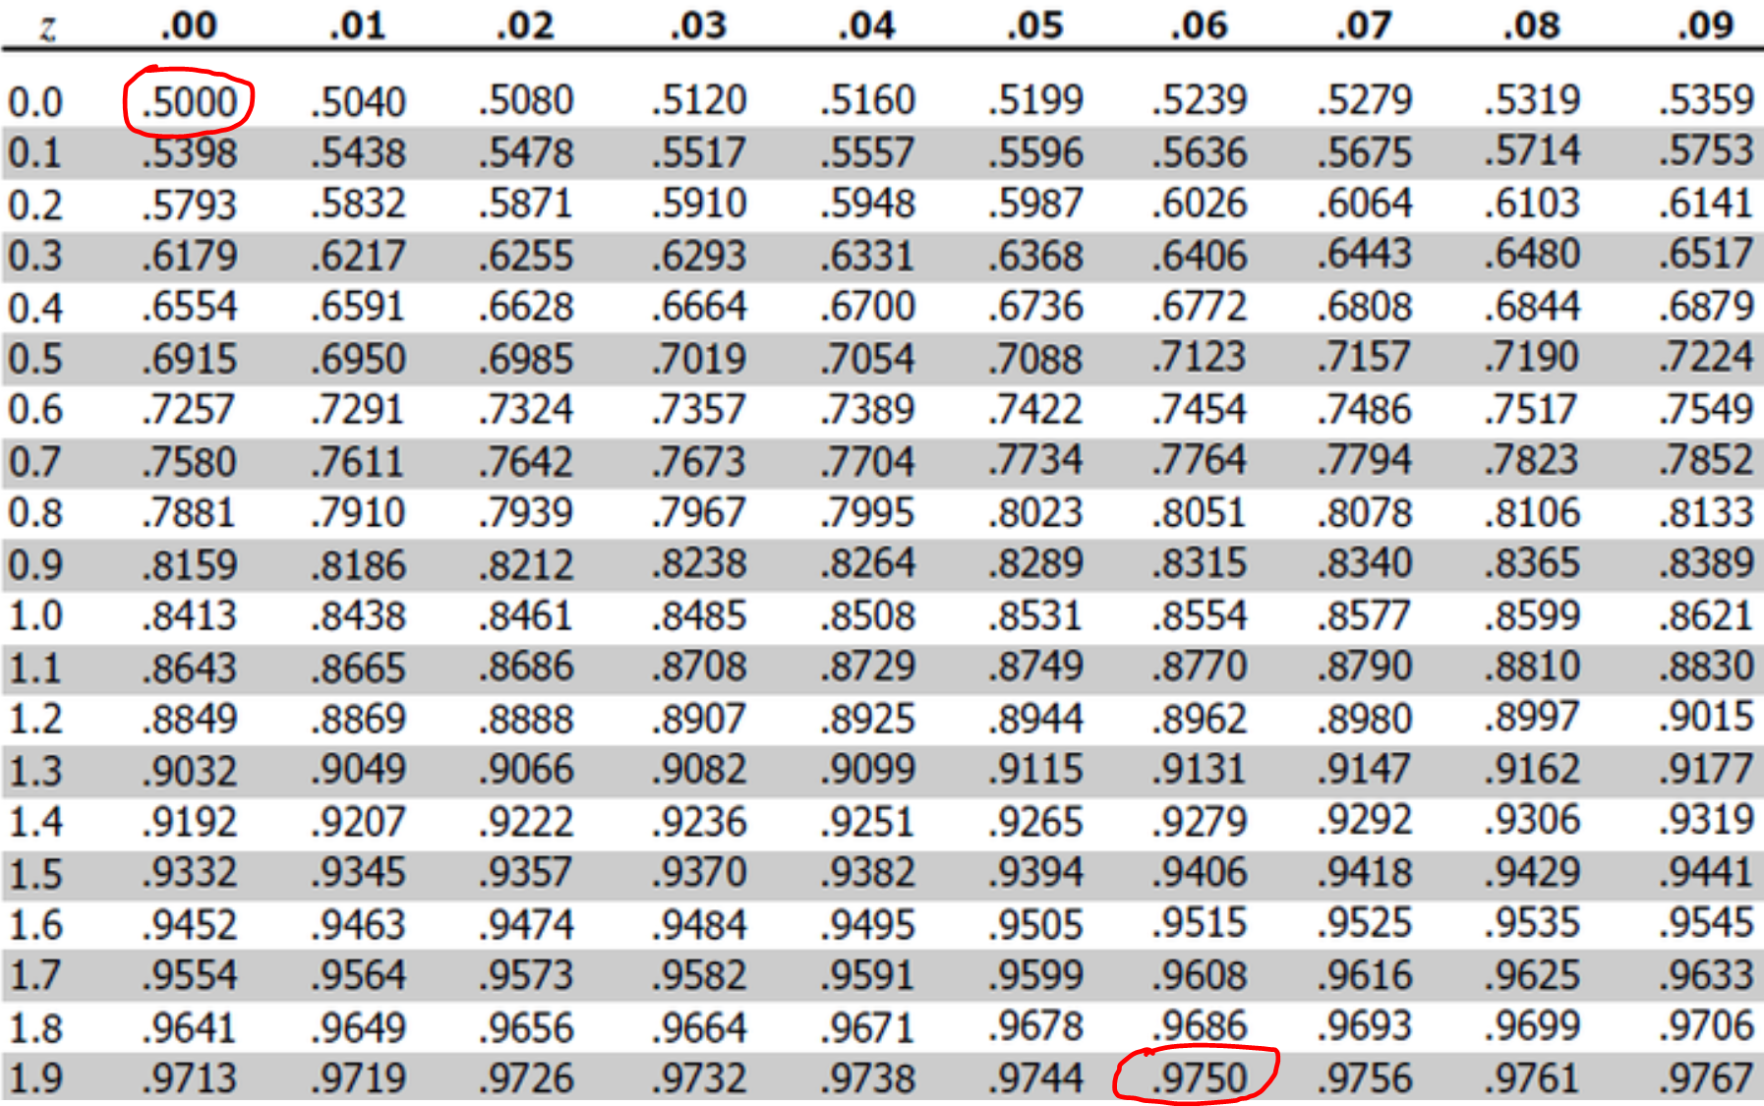
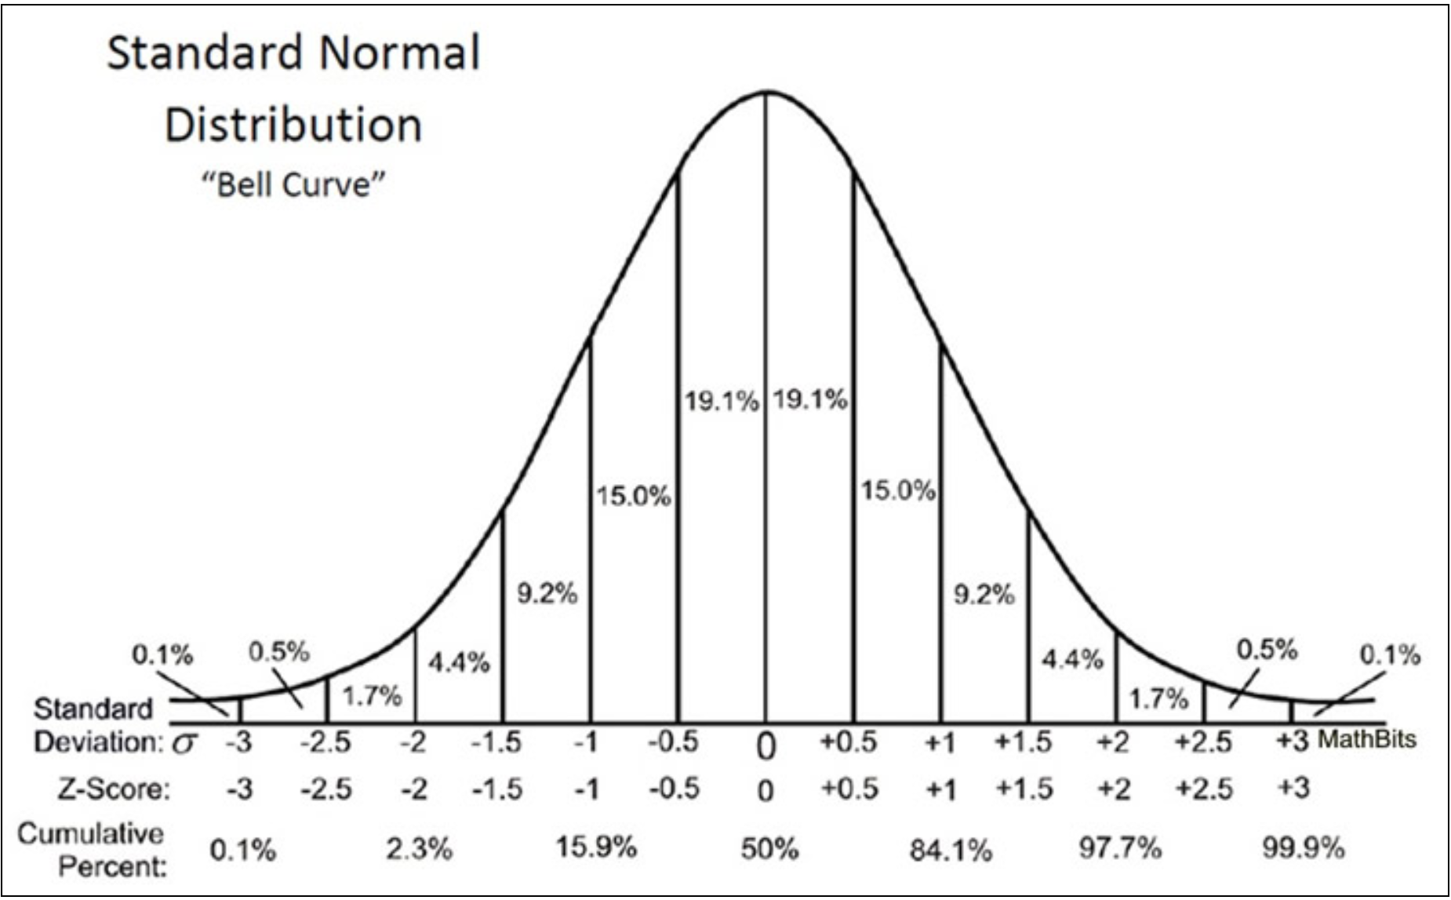
Z-Table & Normal Chart
Here we see a z-score of 0 when at data point is at 0.50, or midway on the normal distribution curve
And we see a z-score of 1.96 that represents the fact that 1-[(1-.975)*2] = 95% of all data points in the large sample should lie within 1.96 standard deviations

Slide 32
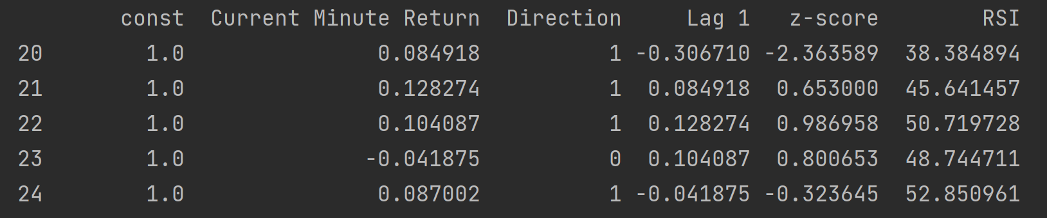
Classifier Intuition
We are building a tree model to predict whether the current minute will be Up or Down (Direction) based on our 3 x-variables: Lag 1, z-score and RSI

Slide 33
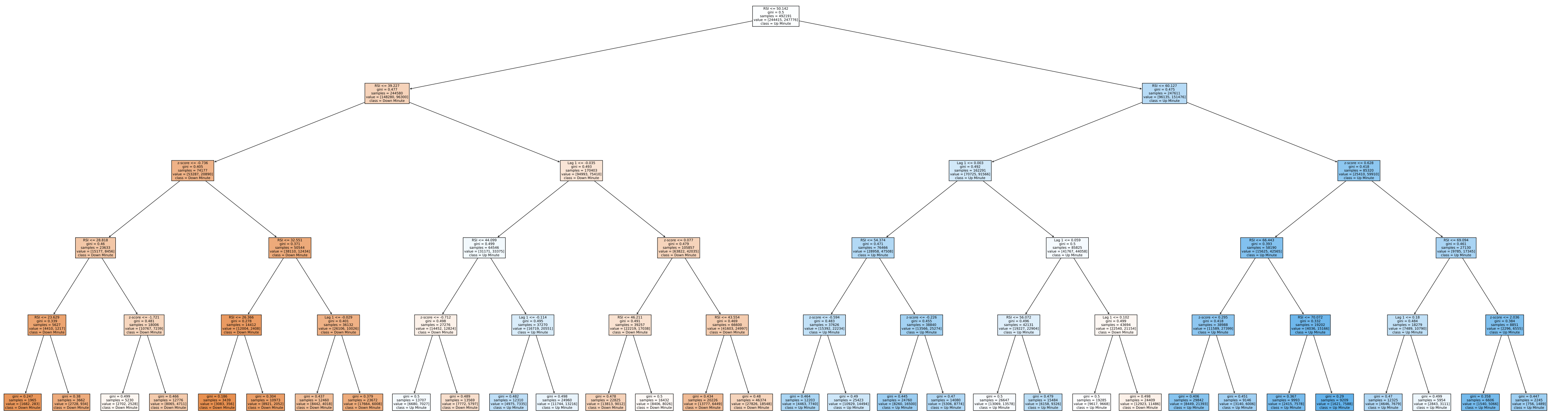
Classification Tree
Please Zoom Into Picture

Slide 34
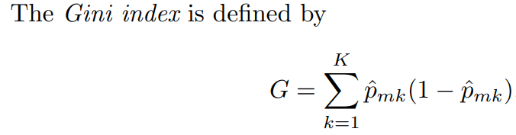
Classifier Characteristics
This tree has 5 levels (not including the root node); too large a level size can cause the model to over-fit the training data
We used the Gini index for the splitting criterion, which produces the purest subtrees; no complete purification occurred since max depth was set to 5
Our max features was set to 2
Pruning was not used, since penalizing complexity increased test error rate
The above parameter selections were found via trial-and-error* by finding which choices produced the least test error rate (and, consequently, the greatest prediction accuracy)
*Optimization and chart techniques also exist
See Scikit-Learn for more details on these parameters

Slide 35
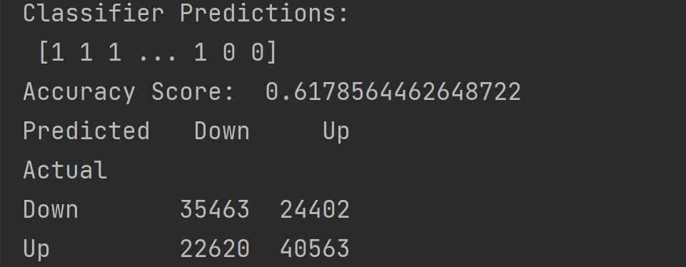
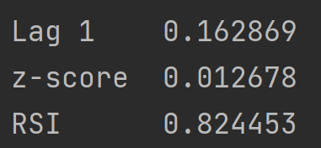
Classifier Results
We found via the Confusion Matrix that our prediction accuracy increases to 61.79% while using Tree Classification from the 52.43% of the Logistic Regression
And the feature most important to predicting the direction is clearly the RSI, with a whopping 82% of the variation explained by the RSI alone
Note that these Confusion Matrix and feature importance results will be slightly different each time the code is run, since the greedy algorithm uses random permutations in tree splitting
You can pass the Random State parameter in the Decision Tree Classifier class to set a seed to the pseudo-random number generator, resulting in reproducible splits

Slide 36
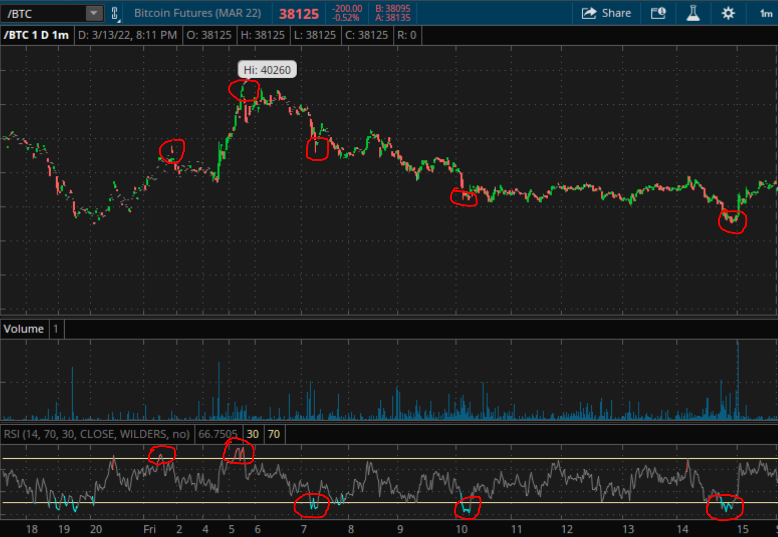
Bitcoin Futures Minute Chart
Volume Chart
RSI Chart
See the bottom-most RSI chart to see why RSI is a stronger predictor than z-score and Lag 1
Over-bought condition is the higher gold line (RSI=70) that corresponds to a sharp fall in bitcoin price on the main chart. And over-sold condition is the lower gold line (RSI=30) that corresponds to a sharp rise in bitcoin price on the main chart

Slide 37
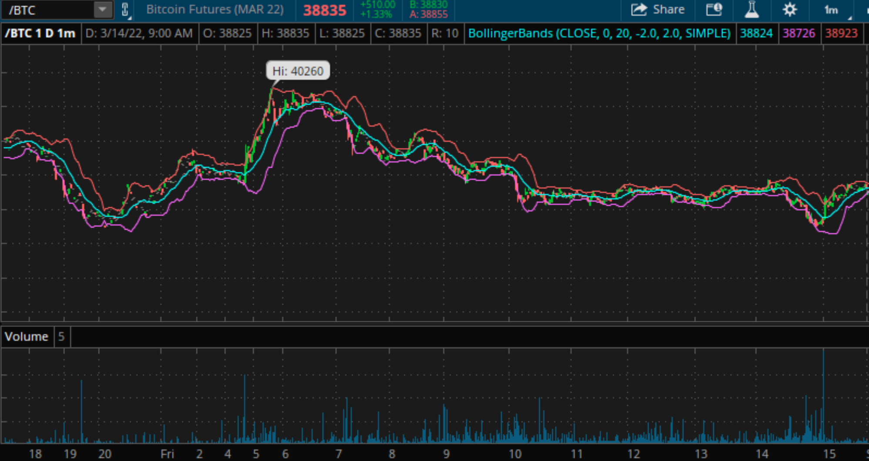
Deviation Bands on Minute Chart
Red curve represents when z-score equals +2 and the purple curve represents when z-score equals -2
However, we determined from our classification analysis that z-score may not be such a great predictor for a minute tick’s direction, relative to RSI

Slide 38
Conclusion: Further Study
Using the Tree Classification model and additional x-variables helped increase our prediction accuracy
Market Makers can bias their decision as when to buy or sell
We can further use a Random Forest model (an ensemble of trees) to attain robustness and reduce Classification Tree variance
We can also search for additional useful signals, such as Moving Average Convergence Divergence, On Balance Volume, Williams Percent Range, Stochastic Oscillator, etc.

Slide 39

Thank you! Any Questions?

Slide 40
References
James, Gareth, et al. An Introduction to Statistical Learning: with Applications in R. Springer, 2021.
https://www.cryptodatadownload.com/data/bitstamp/
https://www.investopedia.com/terms/r/rsi.asp#:~:text=The%20Formula%20for%20the%20RSI&text=The%20standard%20is%20to%20use,average%20loss%20of%20%E2%88%920.8%25
https://www.roelpeters.be/many-ways-to-calculate-the-rsi-in-python-pandas/
https://scikit-learn.org/stable/modules/generated/sklearn.tree.DecisionTreeClassifier.html#sklearn.tree.DecisionTreeClassifier

Slide 41
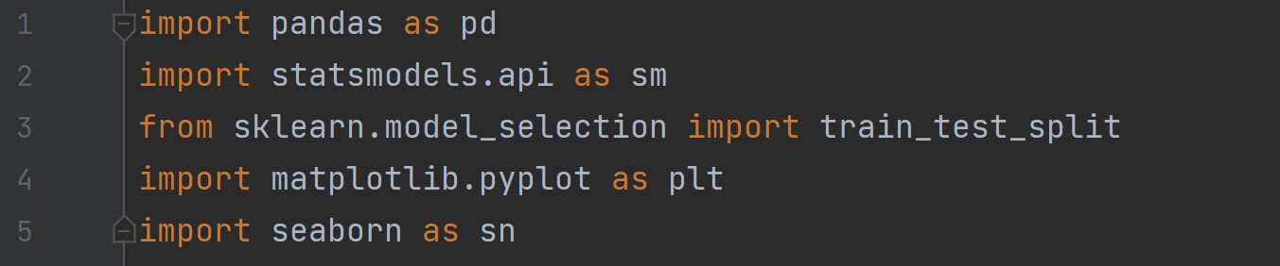
Appendix A: Logistic Regression

Slide 42
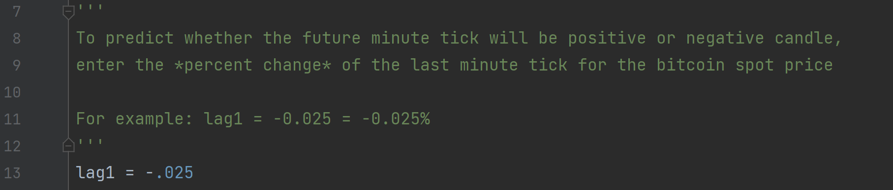

Slide 43
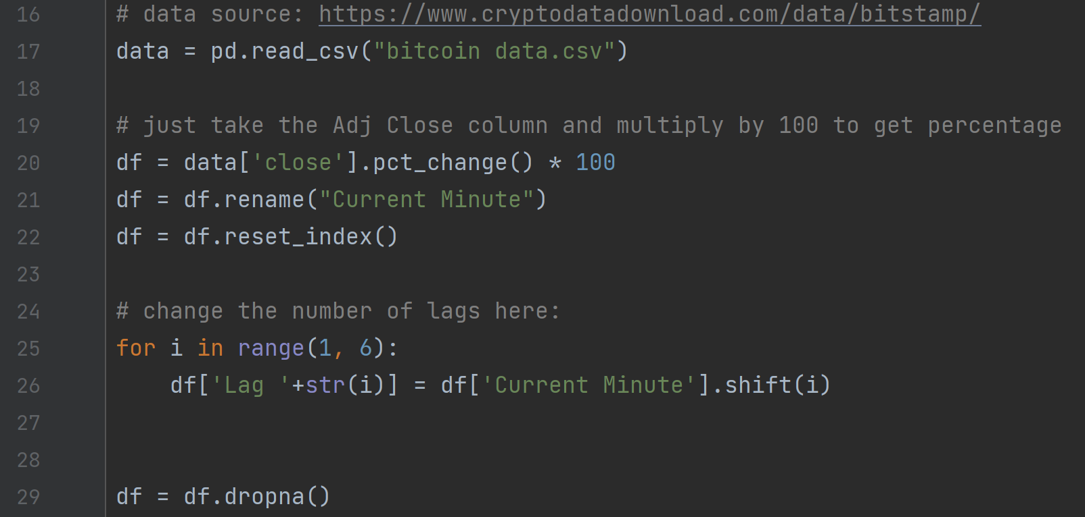

Slide 44
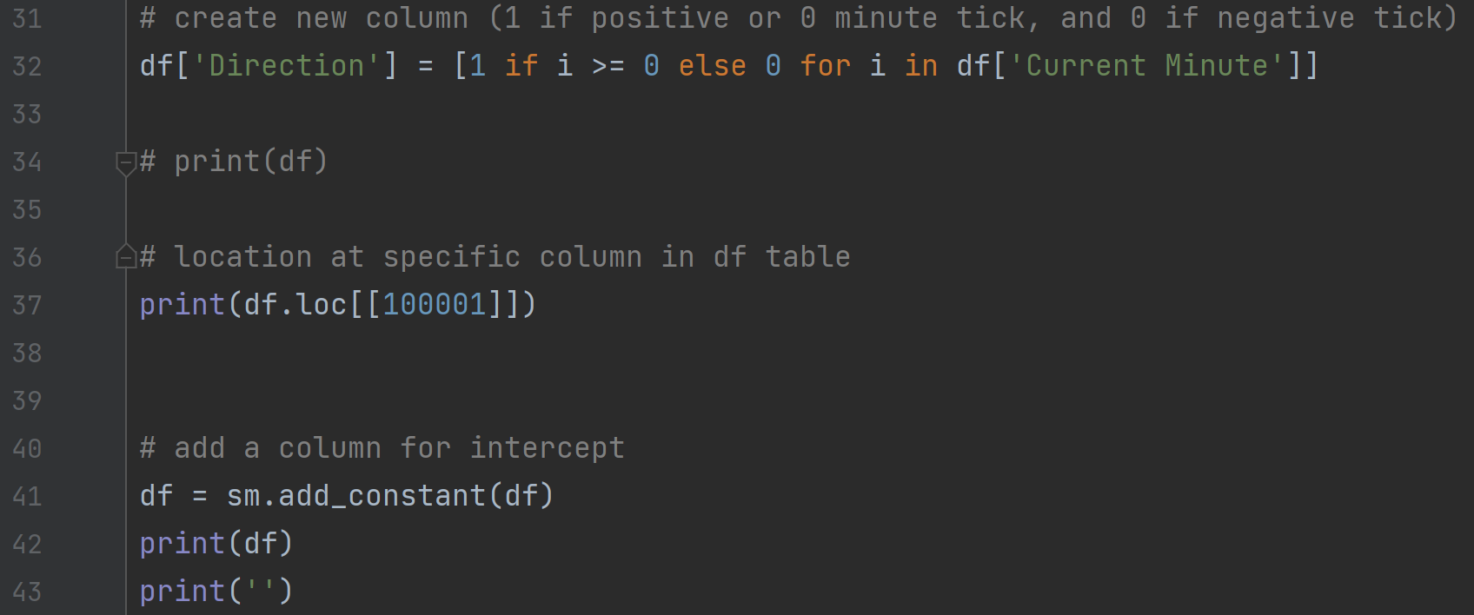

Slide 45
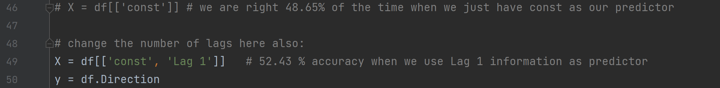

Slide 46
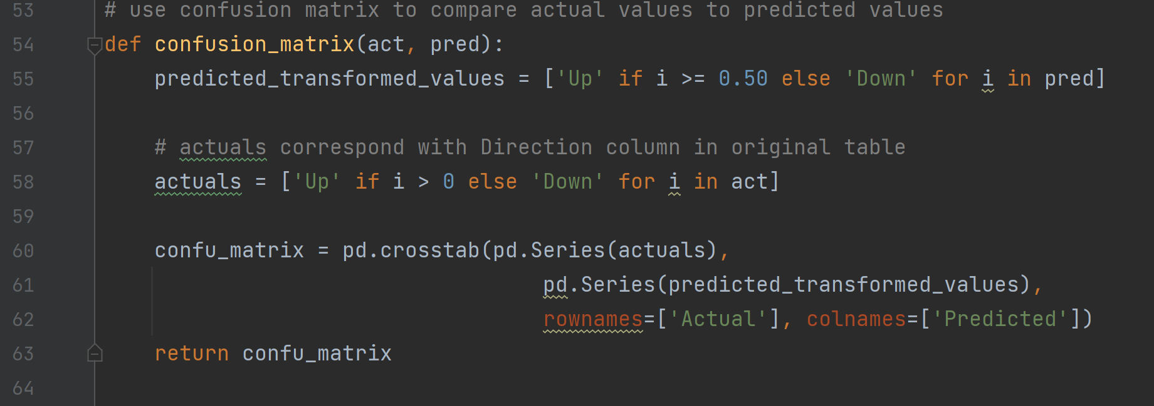

Slide 47
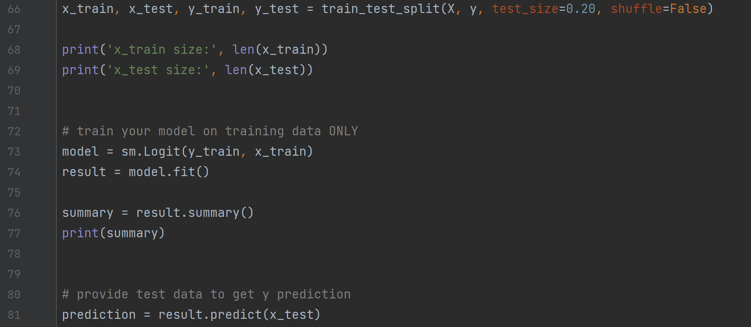

Slide 48
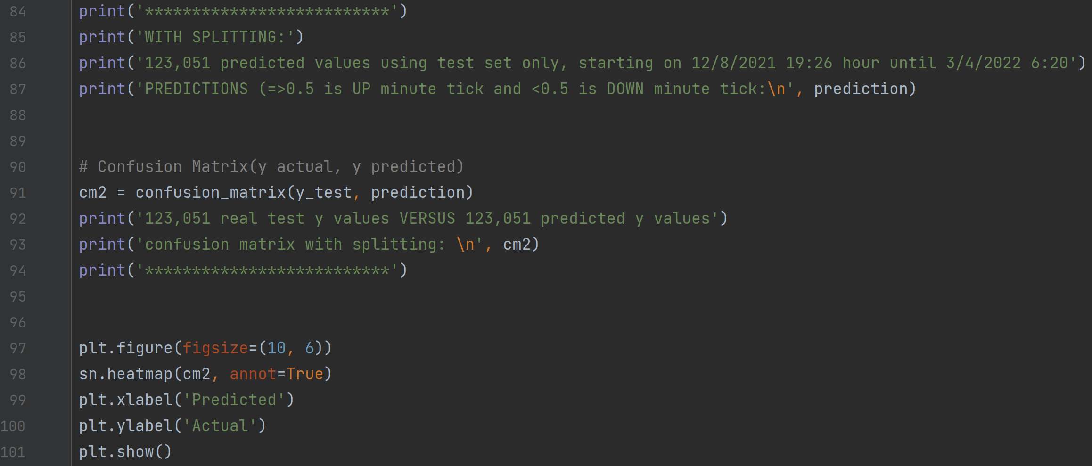

Slide 49
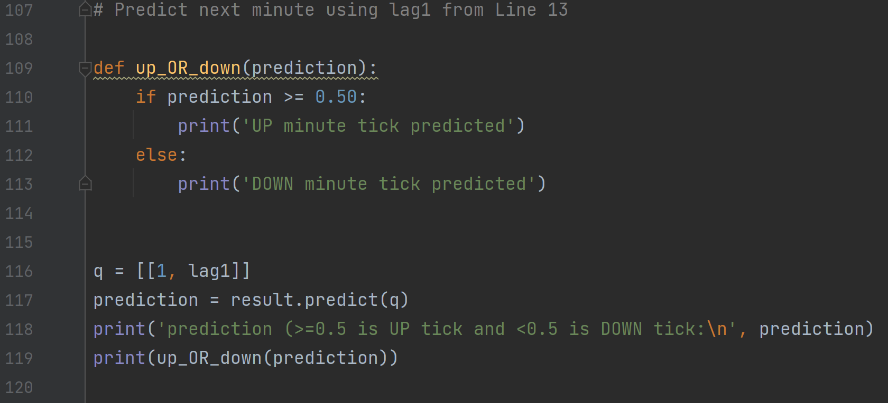

Slide 50
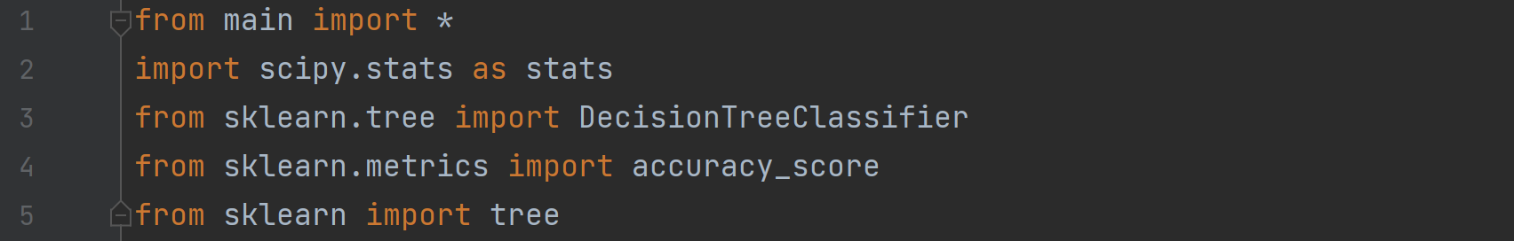
Appendix B: Classification Tree

Slide 51
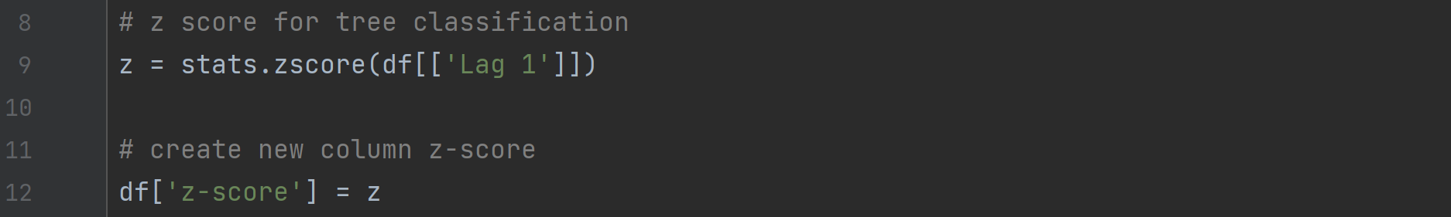

Slide 52
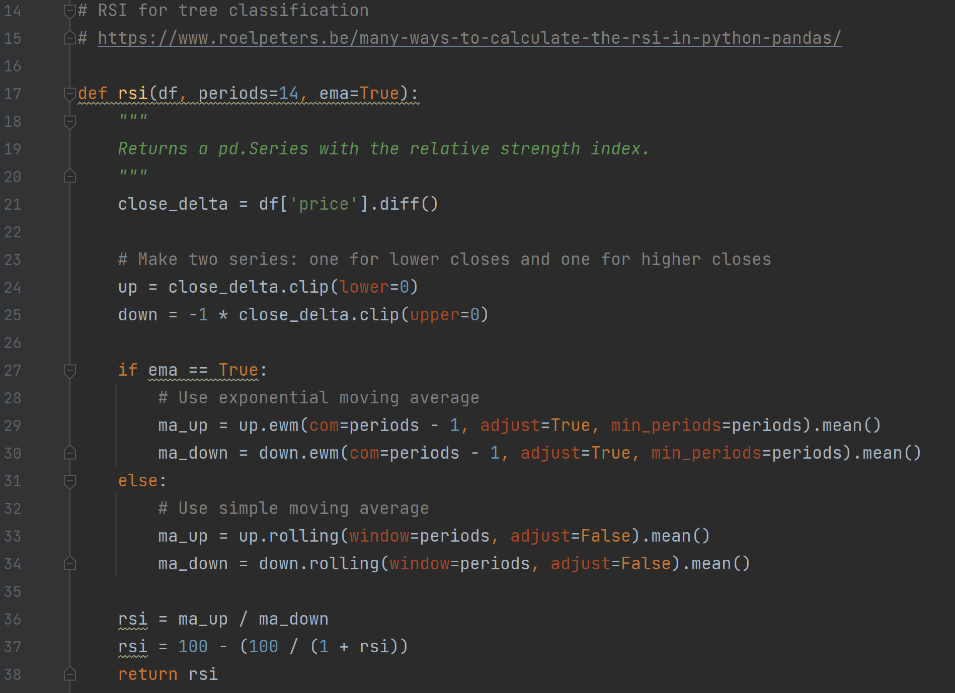

Slide 53
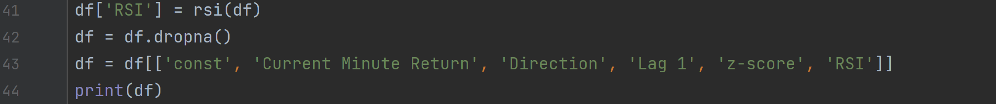

Slide 54
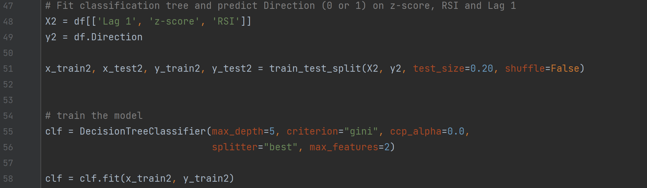

Slide 55
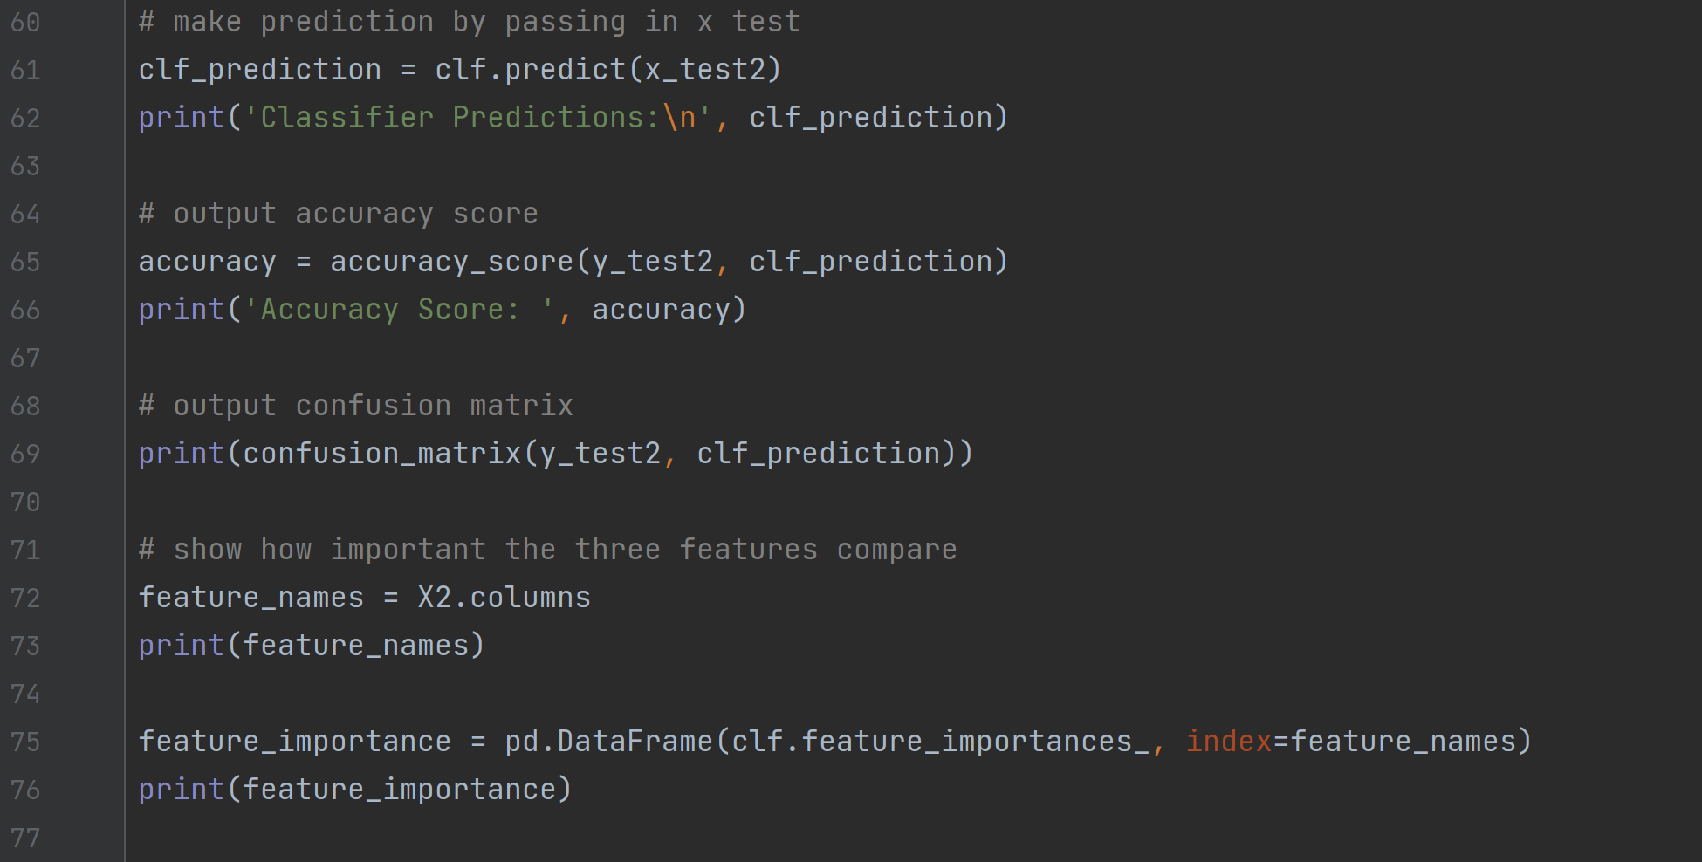

Slide 56
